Slide 1
Smart Home Project
Temperature sensor

Slide 2
Proposal
The project we want to build is a smart home system; it will connect sensors and interactive functional devices of a home with an app and a database. The purpose of this project is to give the user control and overview of their home
Temperature sensor MCP9808
MCP9808 is I2C digital temperature sensor
Accuracy of ±0.25°C over the sensor's -40°C to +125°C range

Slide 3
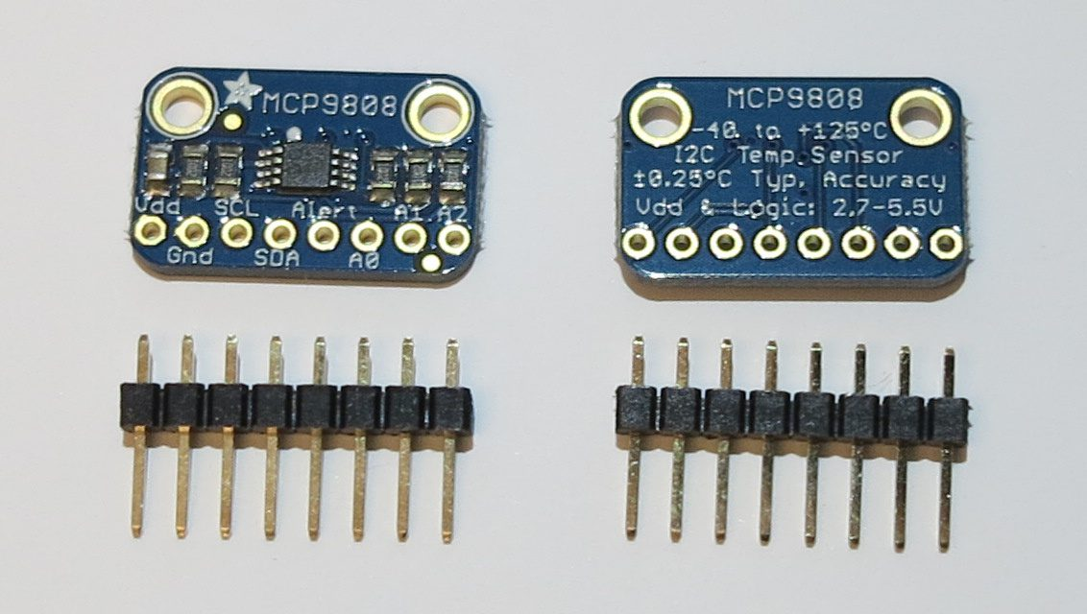
MCP9808

Slide 4
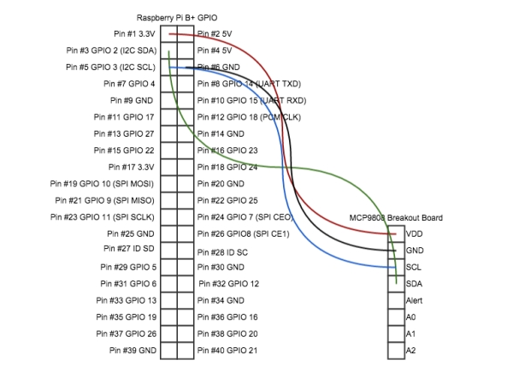
Circuit diagram

Slide 5
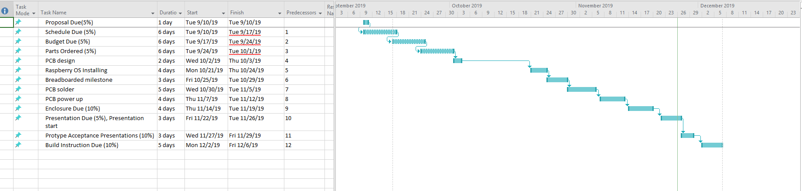
Schedule

Slide 6
Budget
Raspberry 4 from Amazon is $89
MCP9808 temperature sensor is $7.10

Slide 7
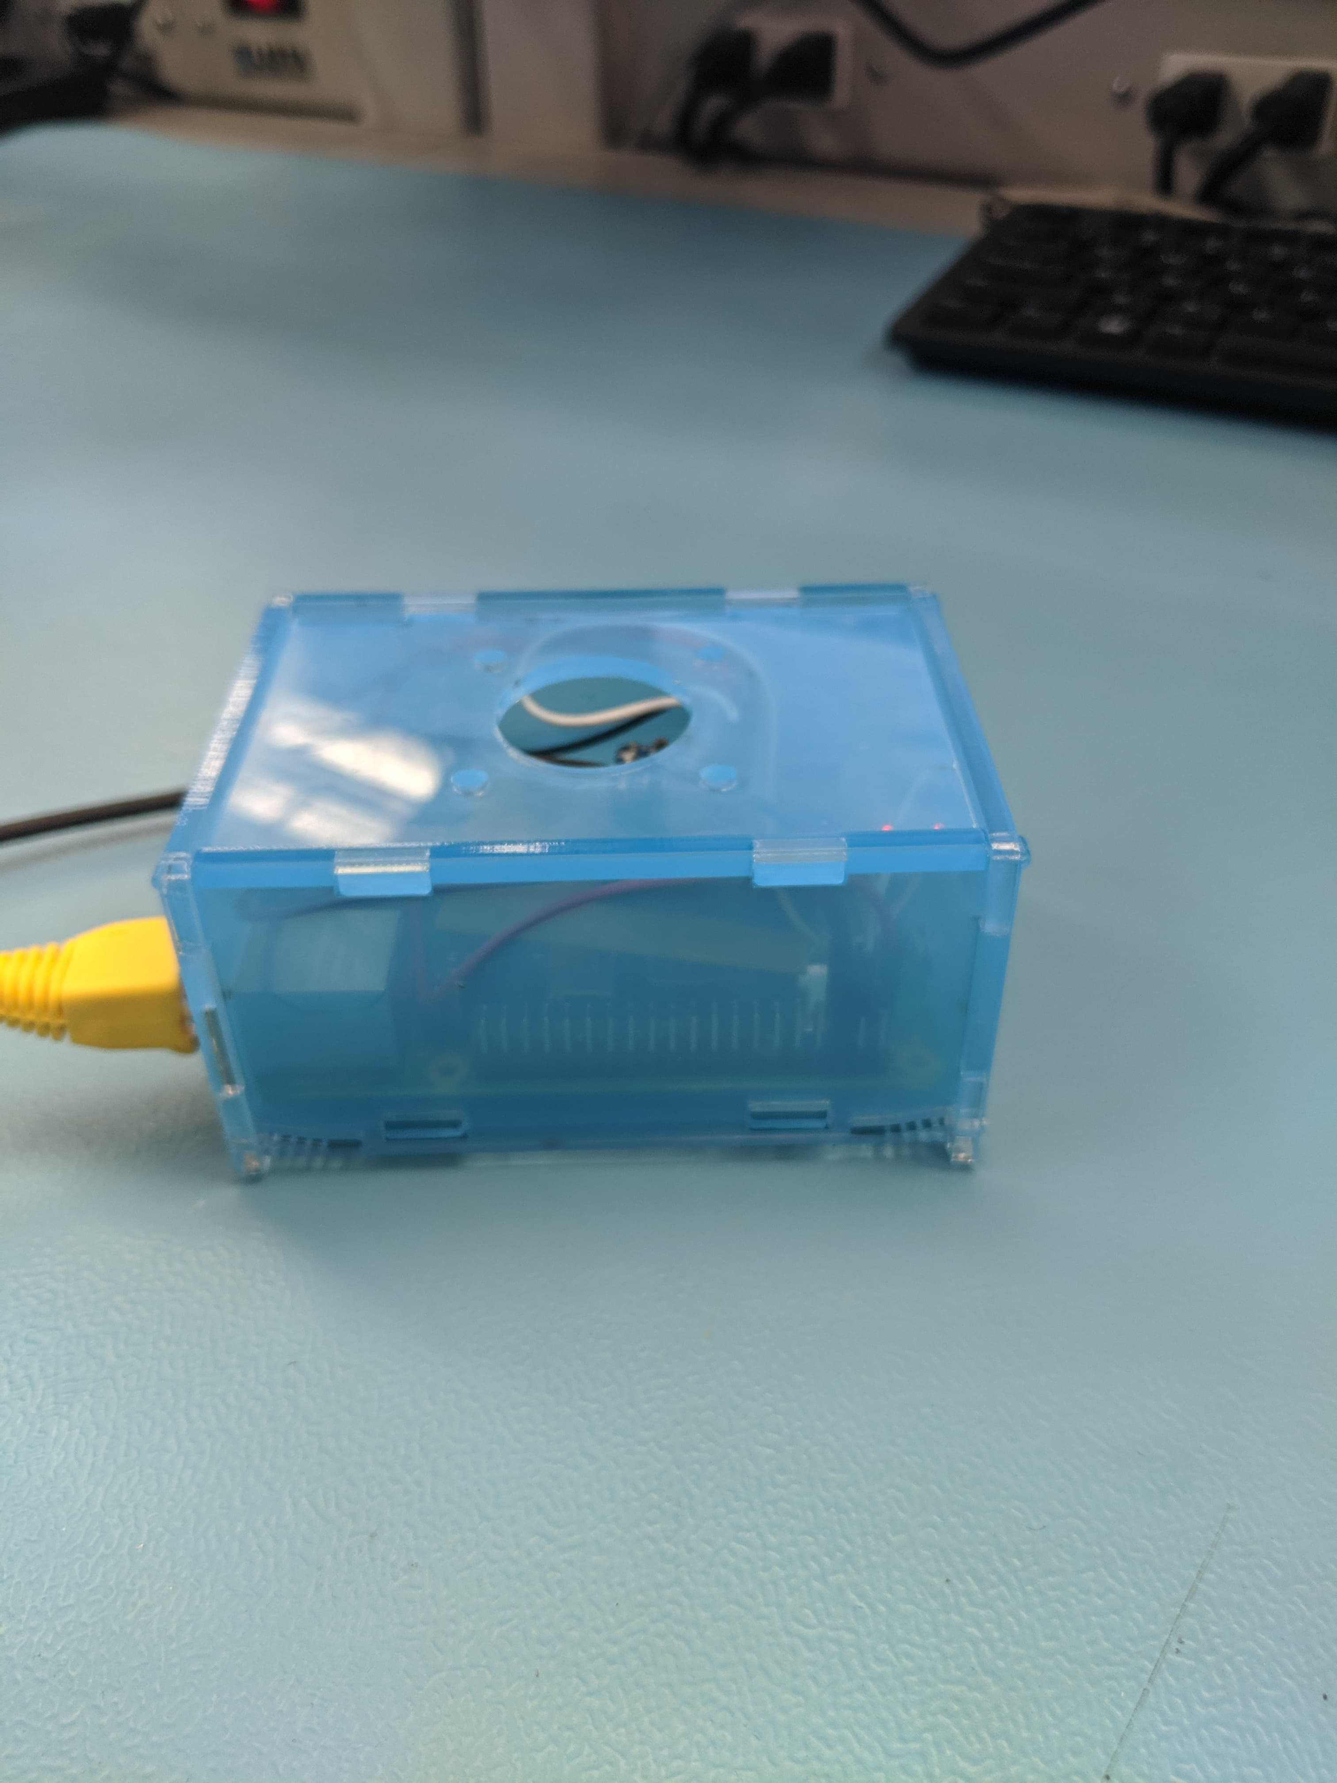
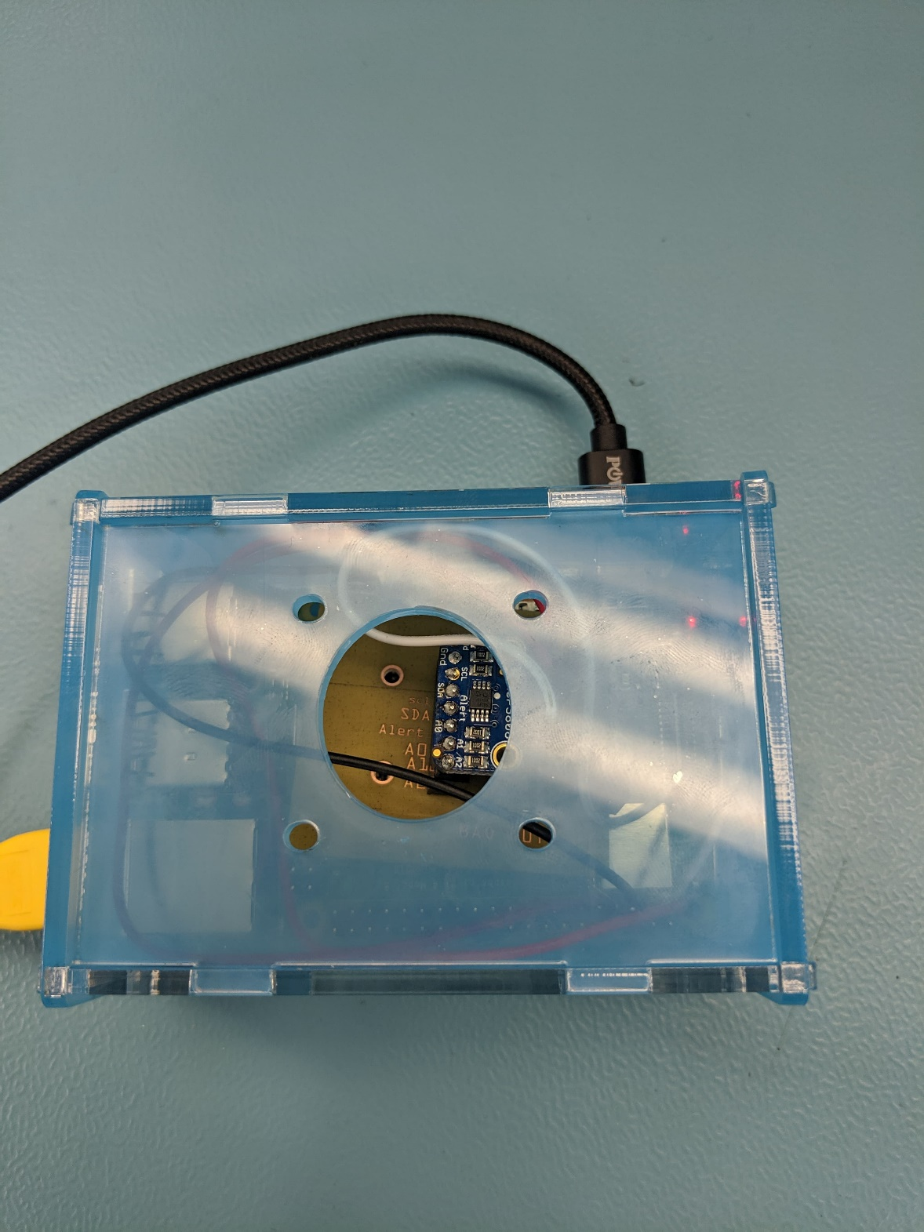
Image about project

Slide 8
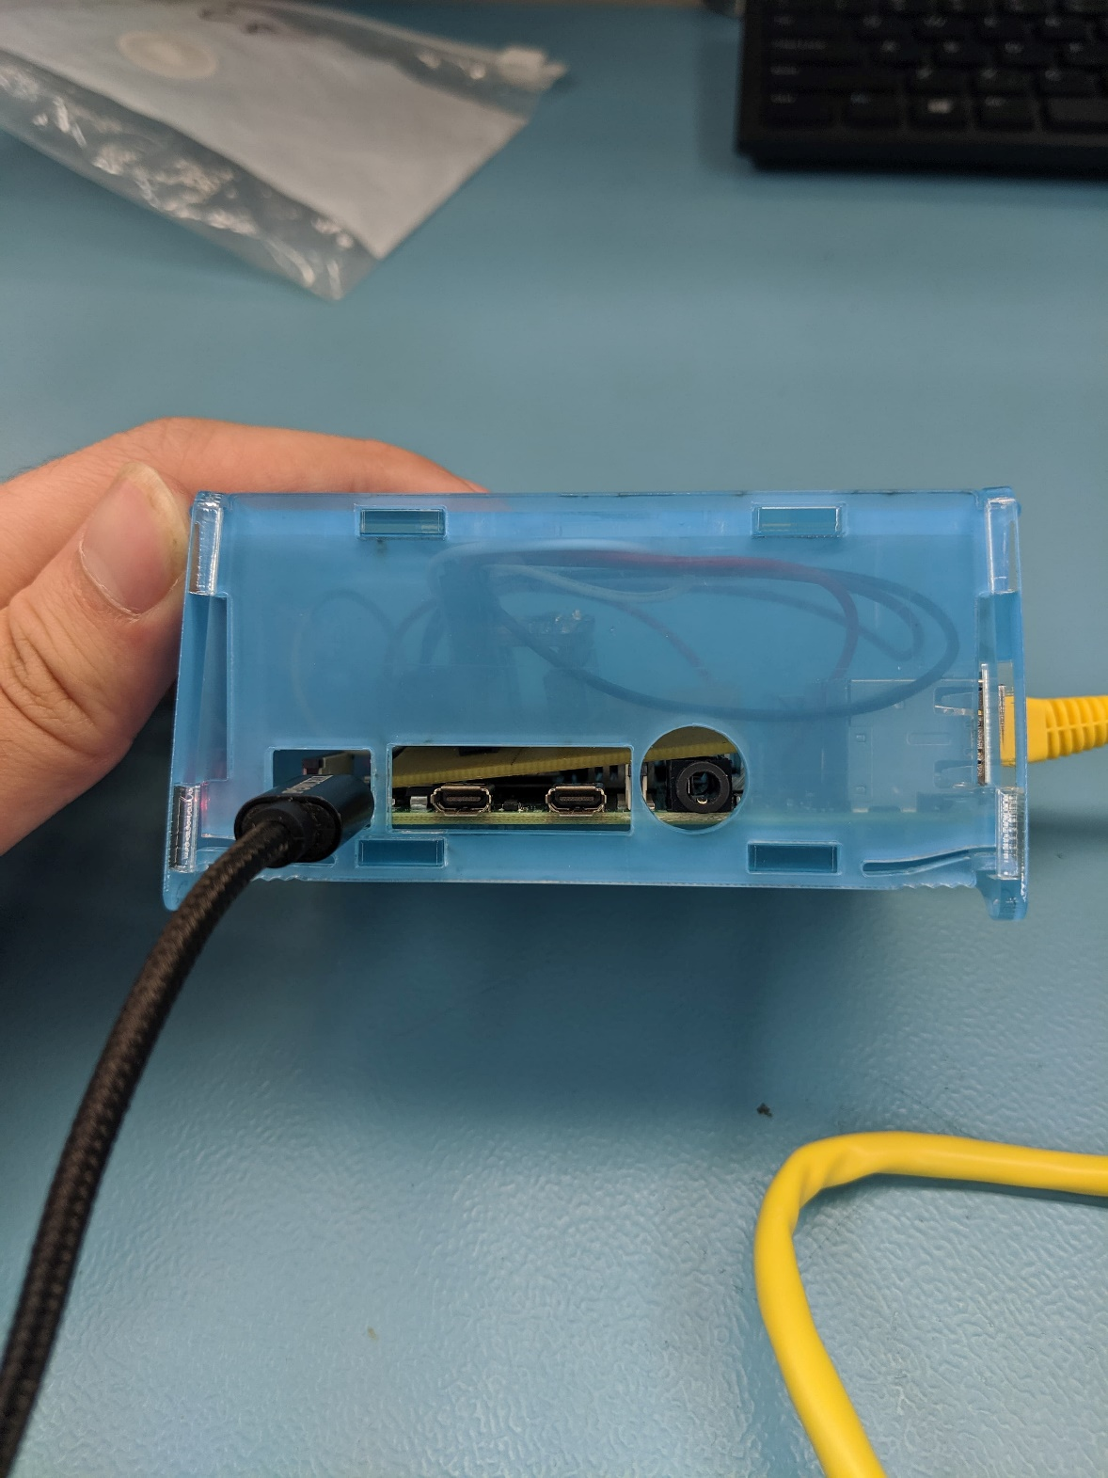
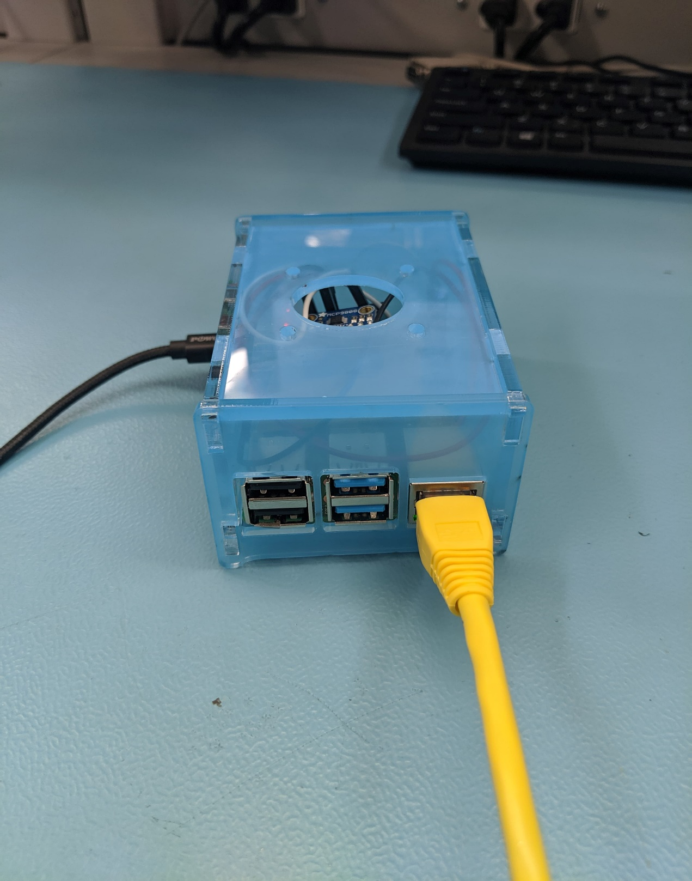
Enclosure

Slide 9
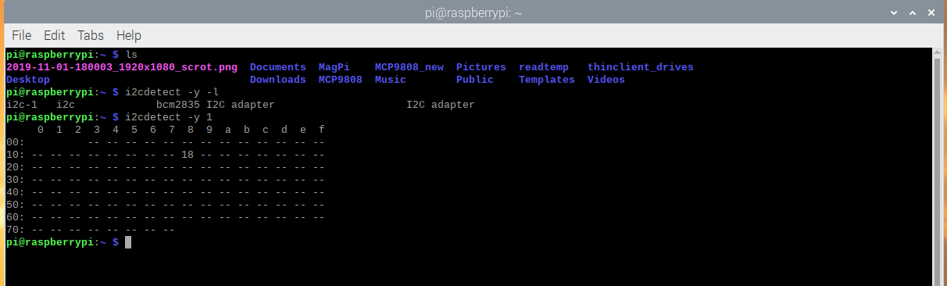
Sensor address

Slide 10
Knowndge from previous course
Tech 150 – Device and circuit – Soldering skill
Tech 103 – Digital and fundamental – Circuit connection

